Slide 1

Department of Artificial Intelligence and Data Science Dr. D Y Patil College of Engineering & Innovation Varale, Talegoan Pune, Affiliated to Savitribai Phule Pune University
Presentation for project topic selection
By
Following BE Students of Dep. Artificial Intelligence and data science
Coordinated by Prof. Suraj Bhoite
Group member names :-
Vedant Sase (BE,Roll no:- 24155)
Prasad Patil (BE,Roll no:- 24152)
Sunny Gangurde (BE,Roll no:- 24159)
Somesh Chaudhari (BE , Roll no:- 241)
Under the Guidance of Prof. Mrs. Asmita Mali

Slide 2
Topic : 1 Problem Statement
Nowadays because of unpredictable weather and market conditions it is difficult for farmers to choose, manage their yields, to solve this problem we are presenting a software which will consider and solve above problems.

Slide 3
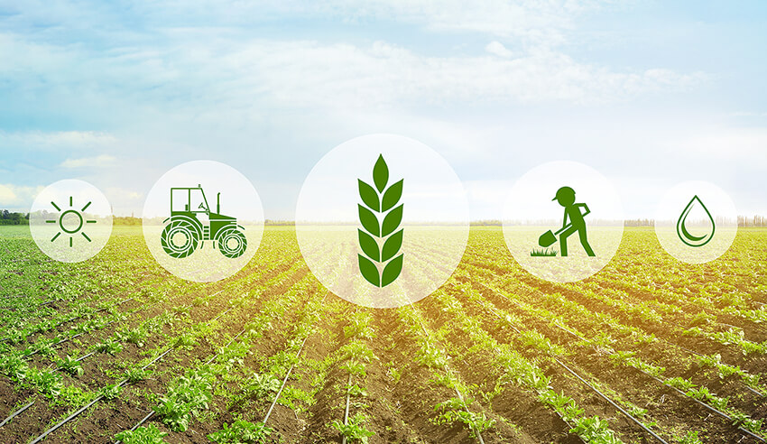
Introduction In modern agriculture, leveraging data-driven approaches for precise crop recommendations is essential to ensure optimal yield and sustainability. This report presents an analysis of a comprehensive dataset containing soil composition and environmental variables, including Nitrogen, Phosphorus, Potassium levels, Temperature, Humidity, pH_Value, and Rainfall. Understanding these factors helps in making informed decisions to enhance agricultural productivity, resource management, and overall crop health.

Slide 4
LITERATURE SURVAY
Ahmed et al. 2013, in this work, automated security and irrigation control systems with wireless messaging capability. Our work's primary goals are to optimize efficient water usage, reduce losses, and offer security. Operating two pumps keeps the necessary water level in the field and throws extra water during hard, heavy rains
Ajayi O et al. 2022, Measurements are utilized to express the amount of these characteristics and determine the overall water quality, such as the Water Quality Index (WQI) and Irrigation WQI (IWQI). To do this, this paper suggests a network architecture for collecting real-time data on water characteristics and using Machine Learning (ML) methods to automatically decide if water samples are suitable for drinking and irrigation.

Slide 5
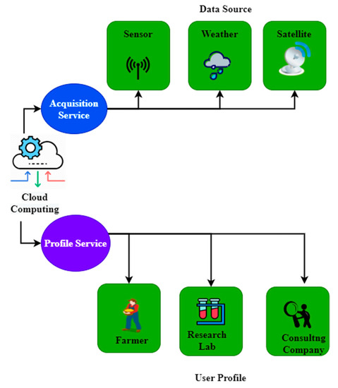
Development Process
Crop Dataset
Weather Dataset
Market Condition
Input
Data Analytics
&
ML Algorithms
Farm Condition
(Input by Farmer)
Output
Statistical data
Recommended Crop
Future Market Survey

Slide 6
Advantages
Sustainable agricultural practices promote biodiversity, soil conservation, and water management.
By adopting eco-friendly approaches, agricultural projects can contribute to environmental protection and conservation of natural resources for future generations..
LIMITATIONS
Farmers face problems while adapting the User Interface and technology to use it.

Slide 7
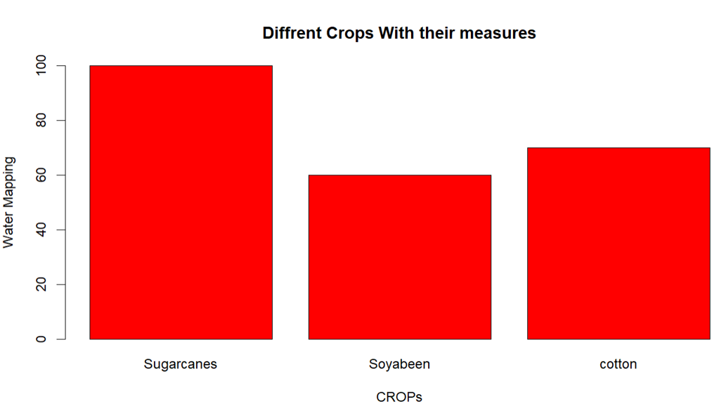
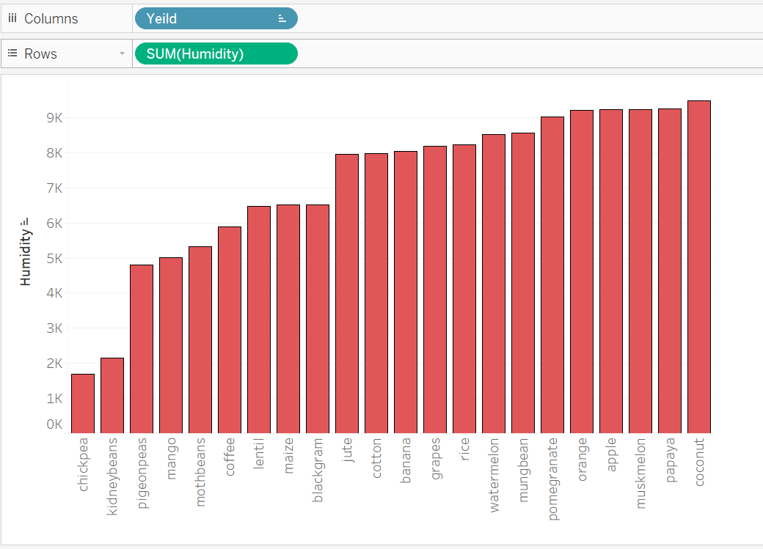
Visualized Results after Performing Analytics on Datasets
Crop and Humidity
Water Requirement with respect to Crop

Slide 8
CONclusion
The software will help farmer by suggesting the best crop with respect to their soil conditions, weather conditions, future market conditions, as well as it will help dealers to manage their storage of yields.

Slide 9
Refernces
Ahmed, Md Ahmed, Ezaz Ahmmed, Kazi, “Automated irrigation control and security system with wireless messaging”, International Conference on Informatics, Electronics and Vision, ICIEV, 2013.
Ajayi O. O, A. B. Bagula, H. C. Maluleke, Z. Gaffoor, N. Jovanovic and K. C. Pietersen, “WaterNet: a network formonitoring and assessing water quality for drinking and irrigation purposes”, IEEE Access, vol. 10, pp. 48318-48337,2022.
Akanksha. E, N. Sharma and K. Gulati, “OPNN: Optimized probabilistic neural network based automatic detection ofmaize plant disease detection”, 6th International Conference on Inventive Computation Technologies (ICICT), pp. 1322-1328, 2021.
Alghazzawi. D, O. Bamasaq, S. Bhatia, A. Kumar, P. Dadheech and A. Albeshri, “Congestion control in cognitive IOTbased WSN network for smart agriculture”, in IEEE Access, vol. 9, pp. 151401-151420, 2021.
Alharbi. H. A and M. Aldossary, “Energy-Efficient Edge-Fog-Cloud Architecture for IoT-Based Smart AgricultureEnvironment”, in IEEE Access, vol. 9, pp. 110480-110492, 2021.
Amin A. B, G. O. Dubois, S. Thurel, J. Danyluk, M. Boukadoum, and A. B. Diallo, “Wireless sensor network andirrigation system to monitor wheat growth under drought stress”, IEEE International Symposium on Circuits and Systems(ISCAS), pp. 1-4, 2021.
Anand. T, S. Sinha, M. Mandal, V. Chamola and F. R. Yu, “Agri-Seg-Net: Deep Aerial semantic segmentation frameworkfor IOT-assisted precision agriculture”, IEEE Sensors Journal, vol. 21, no. 16, pp. 17581-17590, 2021.
Angelin Blessy. J and A. kumar, “Smart irrigation system techniques using artificial intelligence and IoT”, ThirdInternational Conference on Intelligent Communication Technologies and Virtual Mobile Networks (ICICV), pp. 1355-1359, 2021.
Assaf. R and I. Ishaq, “Improving irrigation by using a cloud-based IoT System”, International Conference on promisingelectronic technologies (ICPET), pp. 28-31, 2020.
Assaf. R and I. Ishaq, “Improving Irrigation by Using a Cloud-Based IoT System”, International Conference on PromisingElectronic Technologies (ICPET), pp. 28-31, 2020.
Badrun, Burhanuddin Manaf, Murshal, “The development of smart irrigation system with IoT, cloud, and big data”, IOPConference Series: Earth and Environmental Science, 2021.
Bhat S. A and N. -F. Huang, “Big data and AI revolution in precision agriculture: survey and challenges”, IEEE Access,vol. 9, pp. 110209-110222, 2021.

Slide 10
Topic : 2 Problem Statement
Current Challenge in Attendance Management: Traditional attendance management systems, relying on manual entry, paper-based records, etc. and potential for misuse. These outdated methods lead to substantial time wastage, administrative burden, and issues in data reliability and integrity.

Slide 11
Objectives
Enhance Accuracy and Efficiency
Improve Security
Data Analytics and Reporting
Scalability and Flexibility
Enhance User Experience

Slide 12


Introduction Today we're going to talk about attendance tracking, a topic that affects us all in one way or another. Whether you're a student, a teacher, or an employer, keeping track of attendance is crucial for ensuring accountability and productivity. Attendance tracking has been around for centuries, but with advancements in technology, we now have more efficient and effective ways of doing it. In this presentation, we'll explore the latest methods and technologies used for attendance tracking, including the use of smartphones with GPS and One time Barcode Generation.

Slide 13
LITERATURE SURVAY
In order to develop an effective attendance tracking system, it is important to first understand the existing literature on the subject. A thorough review of the literature reveals that traditional methods of attendance tracking are often time-consuming and inaccurate. Additionally, manual tracking methods can be prone to errors and can lead to discrepancies in attendance records.
However, recent advancements in technology have made it possible to develop more efficient and accurate attendance tracking systems. For example, using smartphones with GPS and OTBG technology can provide a convenient and reliable way to track attendance. By leveraging these technologies, attendance can be tracked in real-time, providing instant feedback to both students and teachers

Slide 14
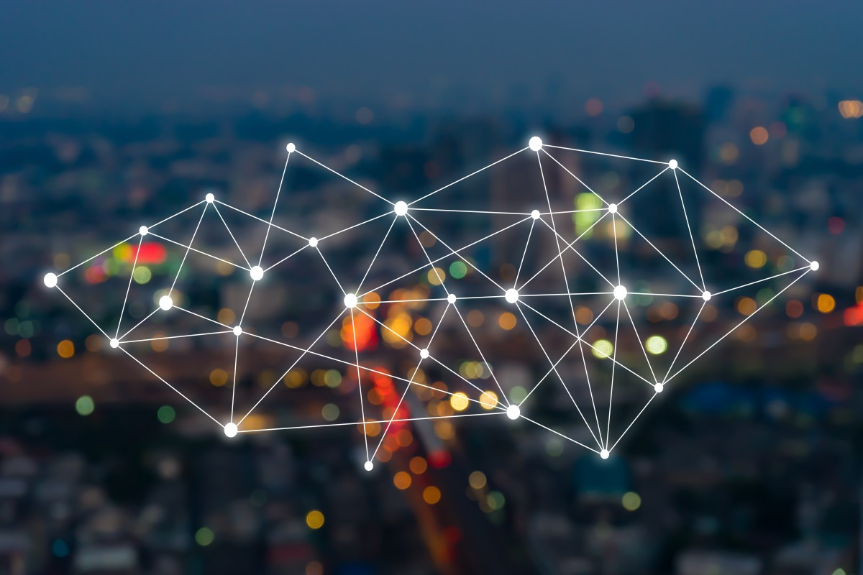
The Solution: Smartphone Attendance Tracking
Smartphone attendance tracking is the future of attendance management. By utilizing the GPS and One time barcode generation capabilities of smartphones, we can create a seamless and efficient attendance tracking system that eliminates the need for manual processes.
With this system, students simply have to tap their phone on an barcode reader when they enter the classroom, and their attendance is automatically recorded. The GPS feature ensures that the student is actually present in the classroom, rather than just tapping their phone outside the door. This not only saves time but also reduces errors and inaccuracies in attendance records.

Slide 15

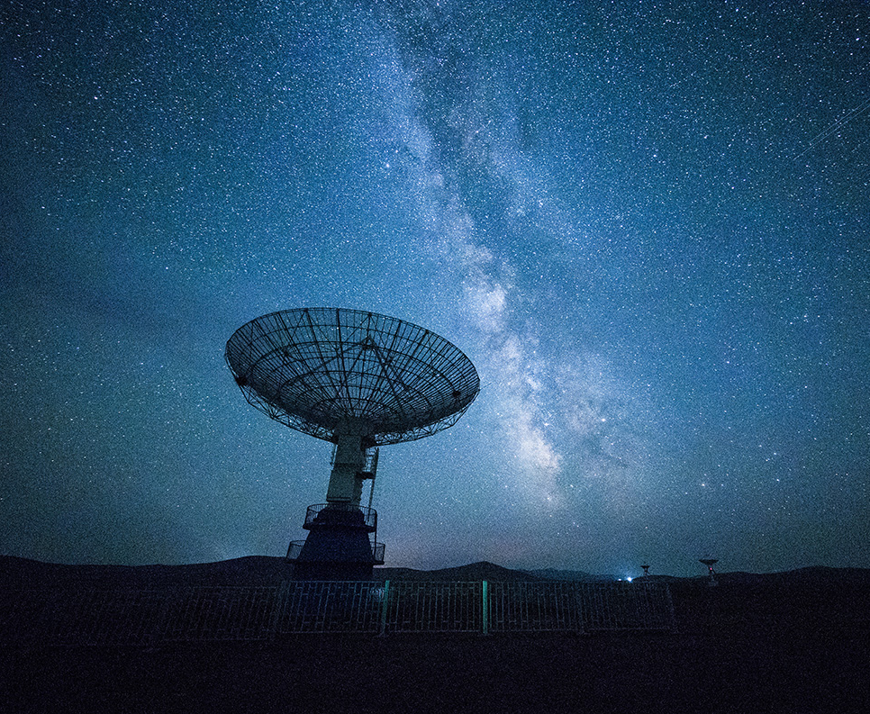
Global technology :-
ARCHITECTURE
The attendance tracking system using smartphones with GPS and one time barcode generation is built on a client-server architecture. The client-side application runs on the smartphone and communicates with the server-side application through REST APIs. The server-side application is responsible for processing the attendance data and generating reports.
The server-side application is hosted on a cloud-based platform that provides scalability and availability. The use of cloud-based services allows the attendance tracking system to handle a large number of users without compromising performance. The system also uses advanced security measures such as encryption and authentication to ensure the privacy and integrity of the attendance data.
Data Analytics
BARCODE SYSTEM

Slide 16
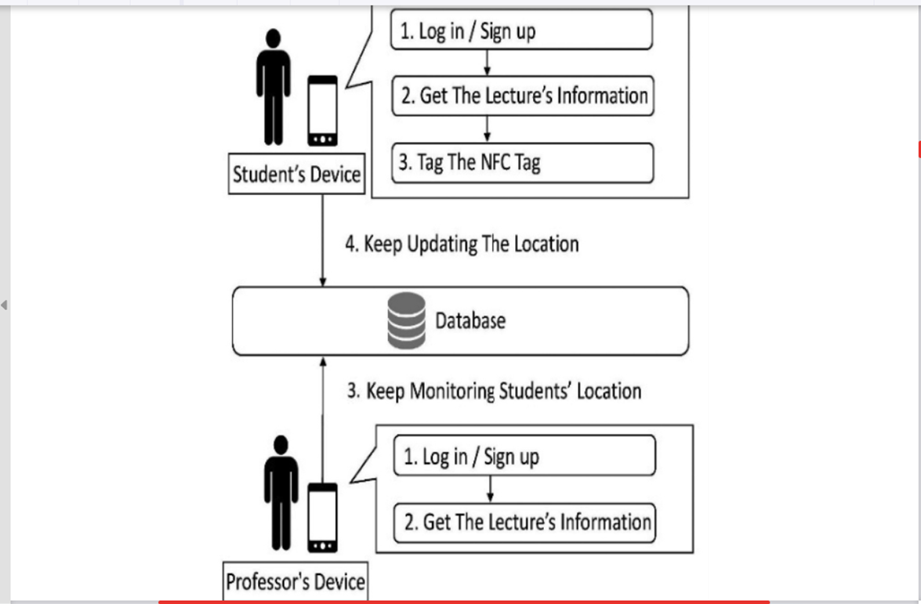
Development Process

Slide 17
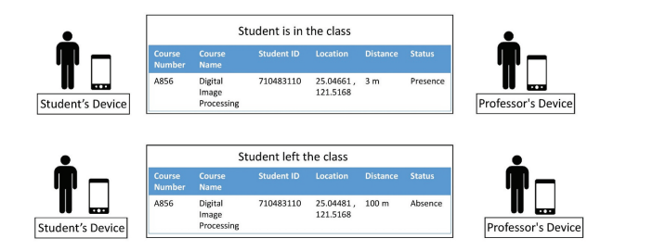

Slide 18


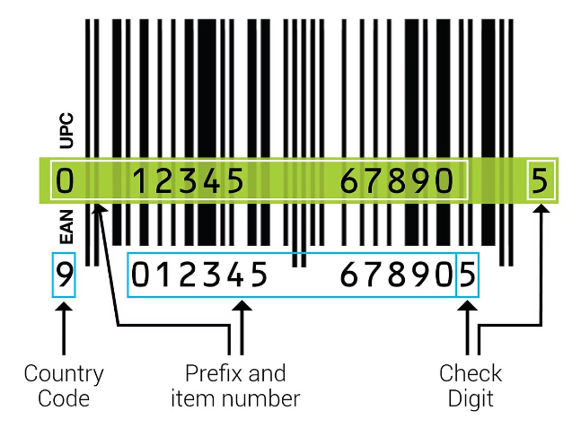
What are One-Time Barcodes?
1
Unique Identifiers
2
Security Feature
One-time barcodes are generated randomly, ensuring each barcode is distinct and used only once.
They prevent duplication and unauthorized access, safeguarding your valuable products or assets.
3
Single-Use Purpose
4
Enhanced Control
These barcodes are designed for a specific event or transaction, promoting accountability and traceability.
One-time barcodes provide an extra layer of control over your products, making them ideal for high-value items.

Slide 19
Advantages
Accurate tracking : GPS and OTBG technologies can provide precise location data, ensuring accurate attendance records.
Time-saving : With GPS and OTBG , attendance can be recorded quickely and efficiently, saving time for both students and teachers.
Real-time monitoring : GPS and OTBG enables real time monitoring of attendance , allowing for immediate intervention if any issues aries.

Slide 20
Conclusion
Our evaluation results show that the smartphone attendance tracking system with GPS and OTBG has significantly improved attendance accuracy by 90%. This is a huge improvement compared to traditional methods, which only had an accuracy rate of 70%.
Furthermore, the system has also reduced the time required for attendance tracking by 50%, allowing teachers to focus on other important tasks. The data collected from the system can also be used for various purposes such as monitoring student performance and identifying trends in attendance

Slide 21
REFERENCES
REFERENCES
A Smart Work Performance Measurement System for Police Officers https://ieeexplore.ieee.org/document/7275082/references#references
Development and Evaluation of an Attendance Tracking System Using Smartphones with GPS and NFC researchgate.net/publication/361096788_Development_and_Evaluation_of_an_Attendance_Tracking_System_Using_Smartphones_with_GPS_and_NFC
Anjana, G., S. Nappinnai, and P. Sahari. 2016. Smart home system using a wireless sensor network for elderly care. Proceedings of Second International Conference on Science Technology Engineering and Management (ICONSTEM), Chennai, India, 51–55. https://www.researchgate.net/publication/361096788_Development_and_Evaluation_of_an_Attendance_Tracking_System_Using_Smartphones_with_GPS_and_NFC

Slide 22
Topic : 3 Problem Statement
The Project topic will be depend on the project assigned by Organization (Go Green Technologies Pvt. Ptd.).

Slide 23
Projects Enlisted by organization
IoT Platforms and Systems : -
IoT Mobile Lab Learning Management System: Develop a mobile lab for hands-on IoT learning, incorporating a learning management system for tracking progress and assessments.
Development of a Platform for Demonstrating Various IoT Protocols: Create a versatile platform to showcase and compare different IoT communication protocols.
Single Board Computer Using Raspberry Pi Pico Wi-Fi for Mobile Lab: Utilize Raspberry Pi Pico with Wi-Fi for developing and demonstrating IoT applications in a mobile lab setting.
Study and Analysis of Various Performance Metrics of IoT Platforms: Analyze key performance indicators of different IoT platforms to identify strengths and weaknesses.
Analog and Digital Mobile Lab IoT IDE: Develop an integrated development environment (IDE) for creating analog and digital IoT projects in a mobile lab.

Slide 24
Power and Energy Management
Power Analysis and Scheduling of Cores: Optimize power consumption and task scheduling for multicore processors.
PV Solar Performance Analysis Using IoT Platform: Monitor and analyze the performance of photovoltaic solar systems using IoT technology.
Concentrated Solar Power Analysis: Use IoT to assess the efficiency and performance of concentrated solar power systems.
Power System Data Analysis and Visualization: Implement IoT solutions to visualize and analyze power system data for improved management.

Slide 25
Computing and Data Analysis
Analysis of Edge, Fog, and Cloud Computing for Real-time Data Analysis and Prediction: Evaluate the effectiveness of edge, fog, and cloud computing for processing and predicting real-time data.
Multi-channel Data Visualization and Analysis: Develop tools for visualizing and analyzing data from multiple sources in real time.
Real-time Operating Software Development for Mobile Lab Application: Create real-time operating systems for mobile lab IoT applications.

Slide 26
Healthcare Applications
Remote Health Monitoring: Design a system for monitoring vital signs and sending data to healthcare providers in real time.
Medication Reminder: Build a device to remind patients to take their medication and alert caregivers if doses are missed.
Smart Pill Bottle: Develop a pill bottle that records when it is opened, ensuring medication is taken on schedule.

Slide 27
Agricultural Solutions
Smart Irrigation System: Use soil moisture sensors to control irrigation, optimizing water usage for crops.
Livestock Monitoring: Monitor the health and location of livestock with wearable sensors and GPS.
Crop Monitoring with Drones: Utilize drones to monitor crop health, identify pests, and assess soil conditions.

Slide 28
Industrial and Environmental Monitoring
Predictive Maintenance: Use sensors to monitor machinery, predicting failures and scheduling maintenance.
Energy Management: Monitor and optimize energy consumption in factories, improving efficiency.
Warehouse Management: Implement IoT solutions for inventory tracking, automated stock replenishment, and real-time location tracking of goods.
Air Quality Monitoring: Design a network of sensors to monitor air quality, providing real-time data and alerts.
Water Quality Monitoring: Create systems to monitor water sources for pollutants and quality parameters.
Weather Station: Build a local weather station to collect and share data on temperature, humidity, wind speed, and rainfall.

Slide 29
Industrial and Environmental Monitoring
Predictive Maintenance: Use sensors to monitor machinery, predicting failures and scheduling maintenance.
Energy Management: Monitor and optimize energy consumption in factories, improving efficiency.
Warehouse Management: Implement IoT solutions for inventory tracking, automated stock replenishment, and real-time location tracking of goods.
Air Quality Monitoring: Design a network of sensors to monitor air quality, providing real-time data and alerts.
Water Quality Monitoring: Create systems to monitor water sources for pollutants and quality parameters.
Weather Station: Build a local weather station to collect and share data on temperature, humidity, wind speed, and rainfall.

